Slide 1


Slide 2


Slide 3



Slide 4

Let’s start by defining “Burning Out”
A little about me

Slide 5

Burning Out is when the effort exceeds the reward

Slide 6

A little about me

Slide 7
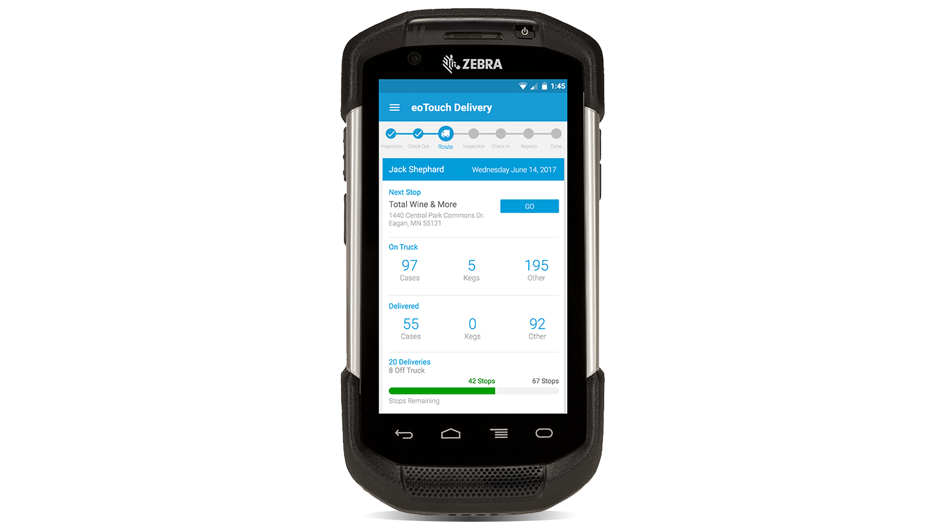

A little about me

Slide 9


My burnout story

Slide 10

Stats on burnout
23% feel burned out often
44% feel burned out sometimes
33% of Workers have never dealt with burnout
https://www.gallup.com/workplace/237059/employee-burnout-part-main-causes.aspx
Notes:
t

Slide 11

2/3rds
WILL FACE
BURNOUT
Notes:
t

Slide 12

The Effects of Burnout
63% more likely to take a sick day
1/2 as likely to discussion performance goals
23% more likely to visit the emergency room
2.6 times as likely to leave current role
13% less confident in their performance
https://www.gallup.com/workplace/237059/employee-burnout-part-main-causes.aspx
Notes:
t

Slide 13

Design Thinking
https://en.m.wikipedia.org/wiki/Design_thinking

Slide 14
Design Thinking according to Wikipedia
“Design Thinking refers to the cognitive, strategic and practical processes by which design concepts (proposals for new products, buildings, machines, etc.) are developed by designers and/or design teams. Many of the key concepts and aspects of design thinking have been identified through studies, across different design domains, of design cognition and design activity.”
https://en.m.wikipedia.org/wiki/Design_thinking

Slide 15

Design Thinking is a structure of creative problem solving for tackling complex challenges

Slide 16





3 Core Stages of Design Thinking
1.
Inspiration
2.
Ideation
3. Implementation

Slide 17
I had to look at my life to understand what was causing my burnout

Slide 18


TOO BUSY
Reason 1
NO VOICE

Slide 19
TOO BUSY
NO VOICE
Reason 2
NO GROWTH

Slide 20

NO VOICE
Reason 3
NO GROWTH

Slide 21

The question
How do we solve our issues?

Slide 22

I came up with an idea…
To read at least 1 business book a month

Slide 23

I came up with an idea…
To read at least 1 business book a month
Learning to stay inspired

Slide 24
Look at inspiration differently
Collect inspiration
You can impact culture

Slide 25

Learning to say no

Slide 26
Look at varied options
Pick the most important
You can say no

Slide 27

Learning to continue growing

Slide 28
It’s ok to not know
Strive to multiple outcomes
Build the right team

Slide 29
Work habits can created
Trigger > Action > Variable Reward > Invest
Apply habit forming to enterprise

Slide 30
Ideas can be infectious
Clear and can Visualize
Make things sticky for stakeholders

Slide 31
Good intentions can sour
Smart people can make mistakes
Don’t lie…

Slide 32
People rarely hear what you say
Concepts of frames
Selling ideas can be learned

Slide 33

Where am I now?

Slide 34

Where am I now?

Slide 35

Look at your own situation
Identify the causes (triggers/stressors)
Plan for how to handle them

Slide 36

Where do you go from here?

Slide 37



Gary Keeler
Youtube.com/c/garykeeler
@iamkeeler
Where do you go from here?

